Slide 1
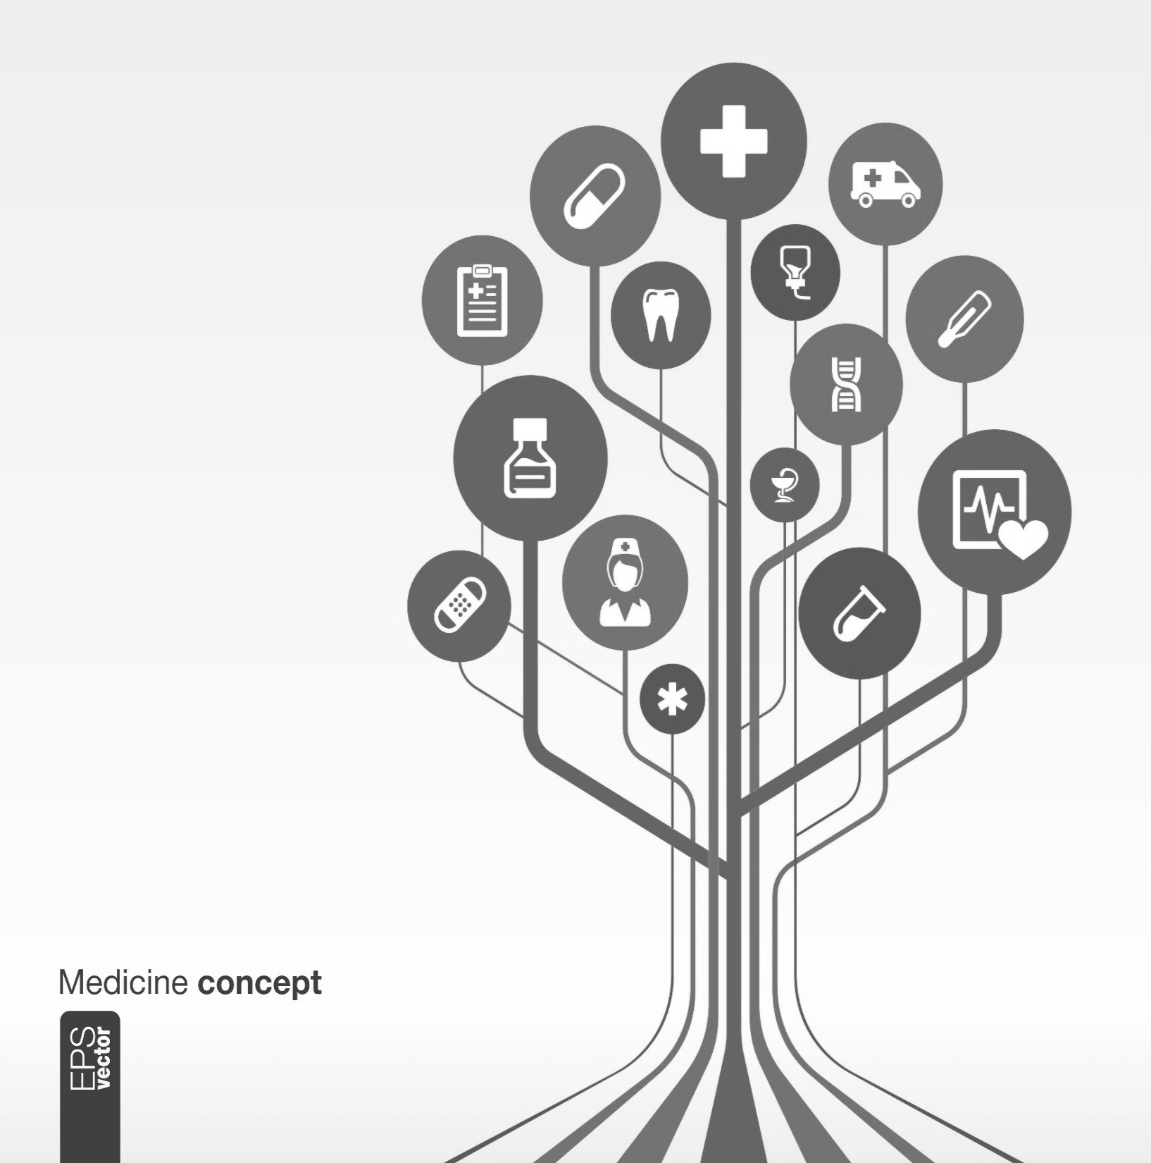

Simplifying Healthcare
Multiplying Prosperity

Slide 2
MediAssist Employee portal
Reimbursement claim submission

Slide 3
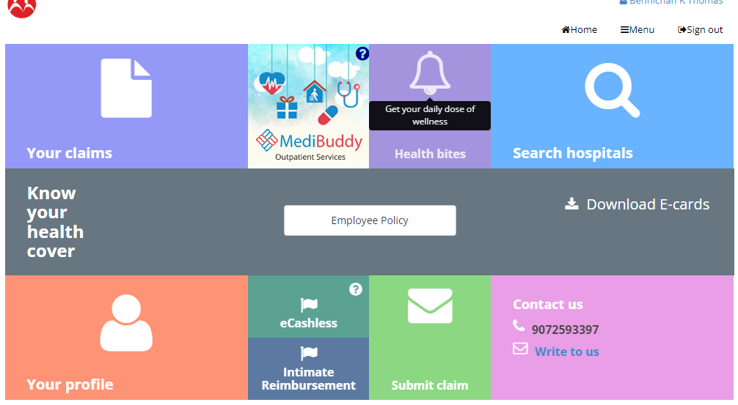
Home Page

Slide 4
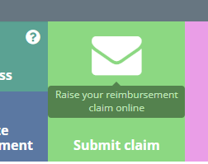
Click “Submit Claim”

Slide 5

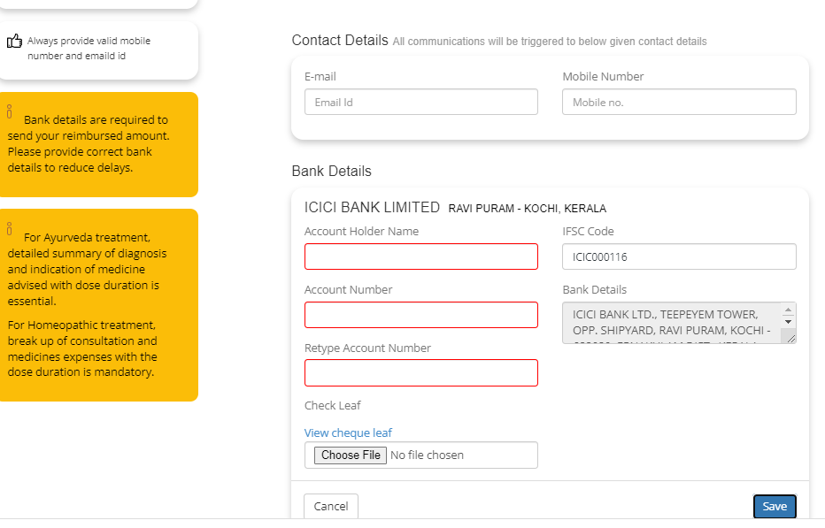
Hospitalization details-Fill all mandatory fields
Email
Mobile No
A/c No/IFSC Code
A/c Holder Name
A/c Number
Fetch Bank details
Attach Copy of Cheque

Slide 6
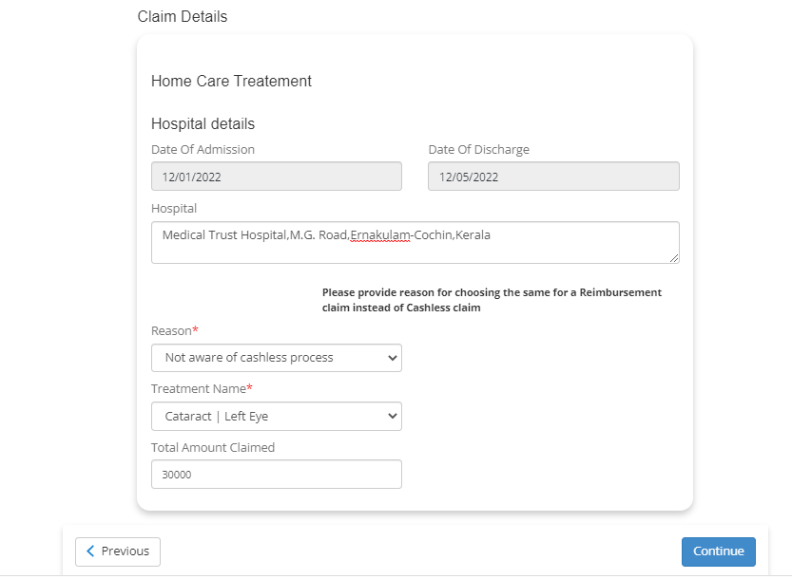
Claim details
DOA & DOD
Hospital Name
Reason
Treatment Name
Total Amount Claimed
Fetch Bank details
Attach Copy of Cheque

Slide 7
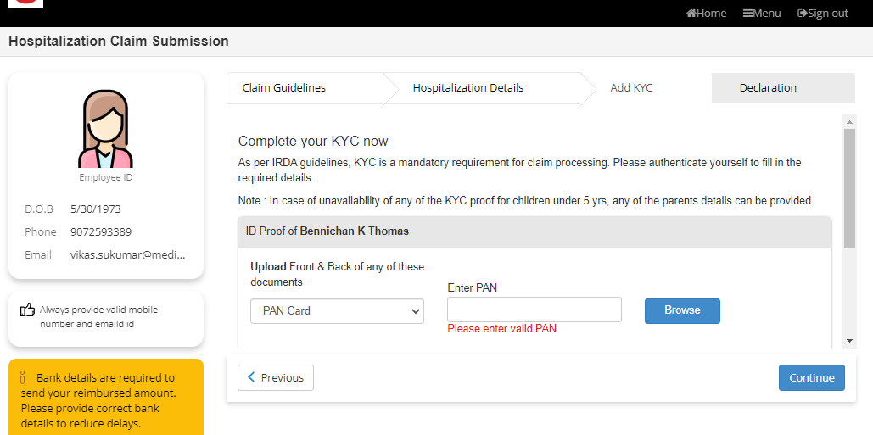
Add KYC
PAN Card
Govt.ID proof-Aadhaar/DL
Attach Soft copies
Treatment Name

Slide 8
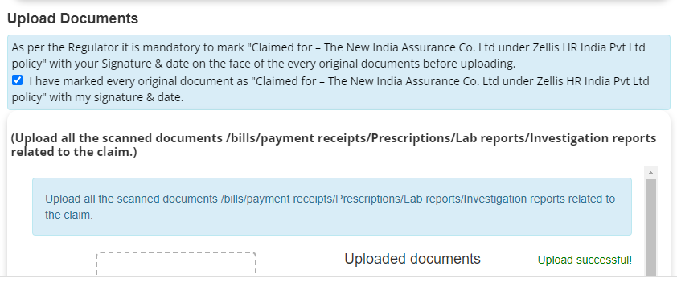
Upload Claim Documents
Upload Soft Copy all claim document

Slide 9
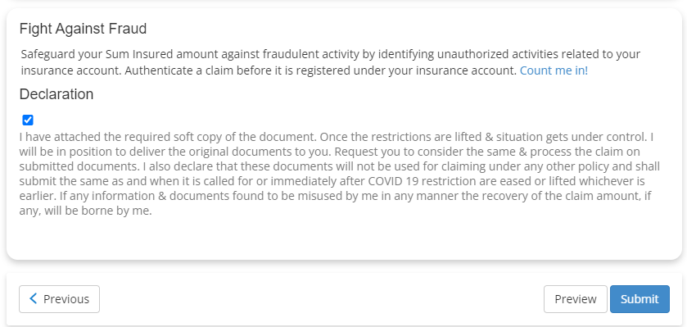
Upload Claim Documents
Click on declaration and submit

Slide 10
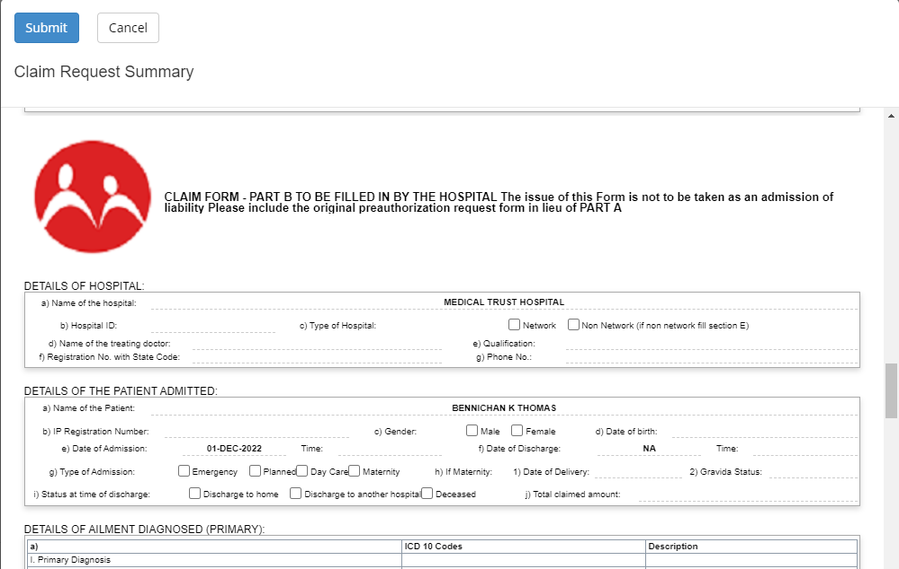
Complete claim form and submit
Complete claim form and submit

Slide 11
THANK YOU

